Slide 1
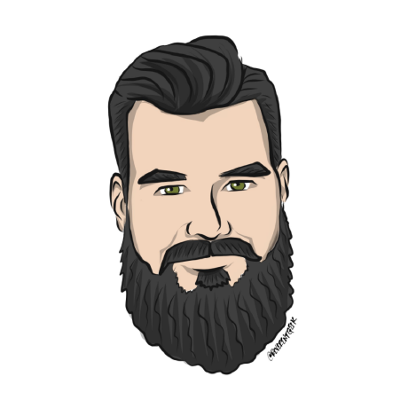


Managing multiple models in production
Terry McCann | @SQLShark
Principal Data Scientist

Slide 2
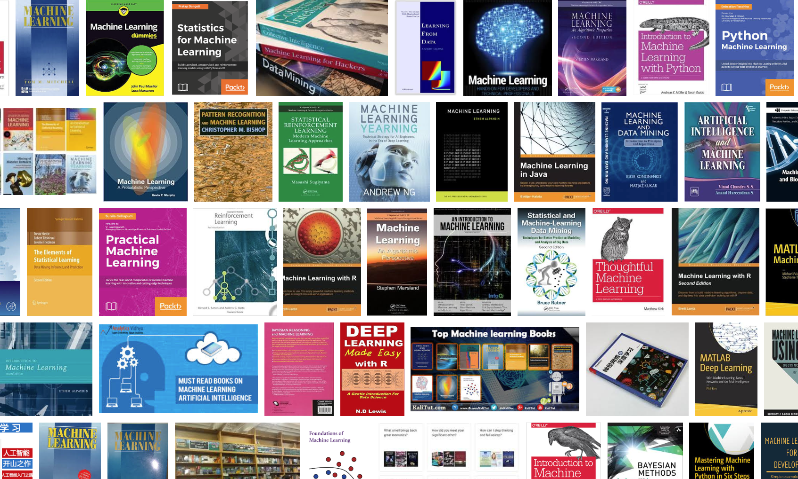
Notes:
Pick up a book on Machine Learning and they will all tell you how to do machine learning. They will give you their process

Slide 3
The Machine Learning Process
Gathering data
Preparing that data
Choosing a model
Training
Evaluation
Hyperparameter tuning
Prediction
Deployment
https://towardsdatascience.com/the-7-steps-of-machine-learning-2877d7e5548e

Slide 4

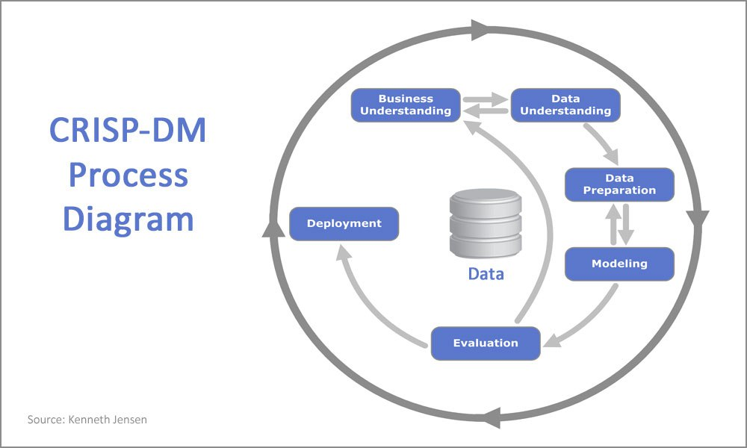
Terry McCann 2017

Slide 5

Perfect model?

Slide 6
“Productionisation of models is the TOUGHEST problem in data science”
Schutt, R & O'Neill C, 2014. Doing Data Science Straight From the Front Line, O'Reilly Press. California
Notes:
Meet a great bunch of people
You’re a point of authority
You get to shout at people
You get in for free (save a bit of money)
Free drinks

Slide 7
What is wrong with the development process?

Slide 8

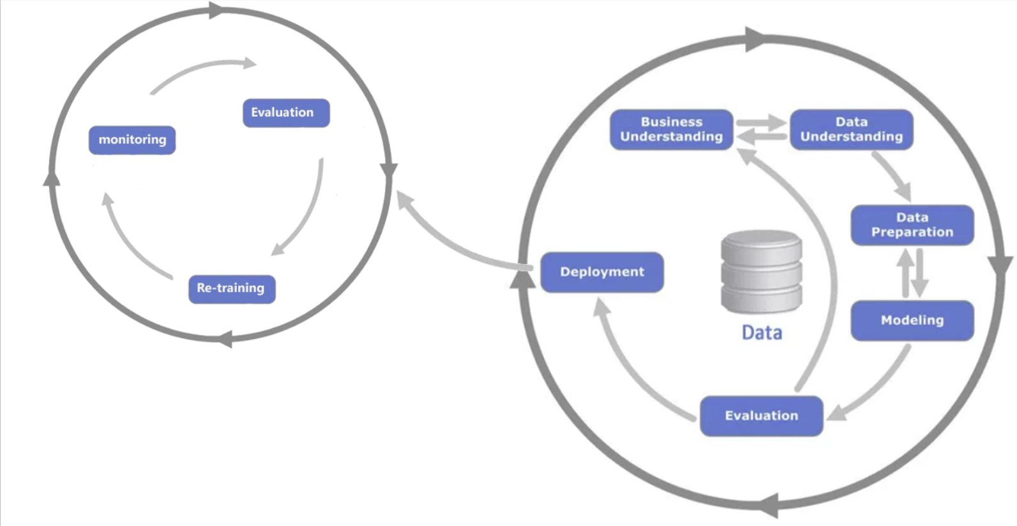

Terry McCann 2017

Slide 9
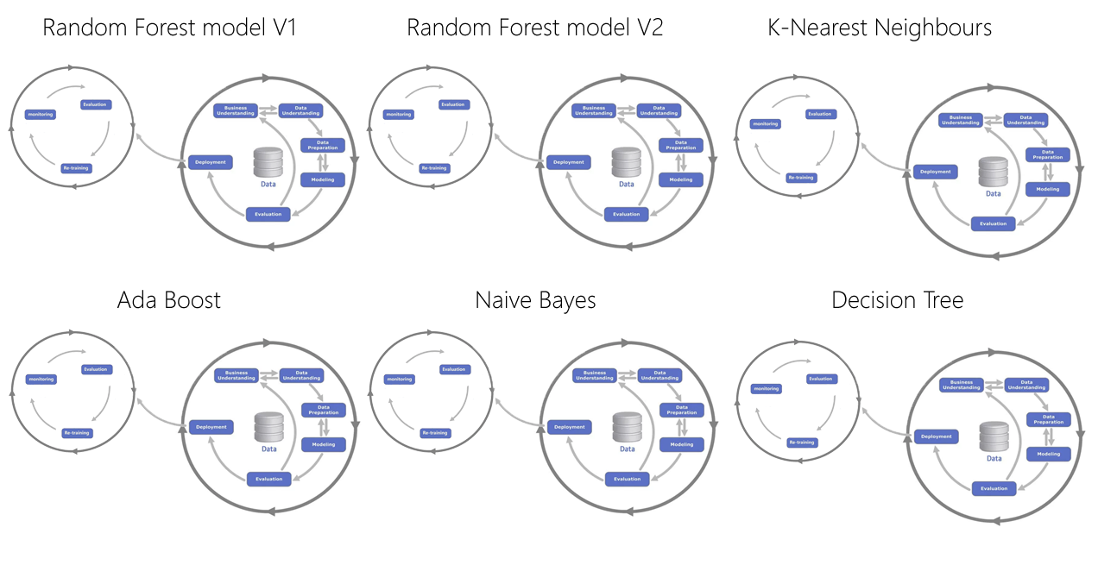
Terry McCann 2017

Slide 10
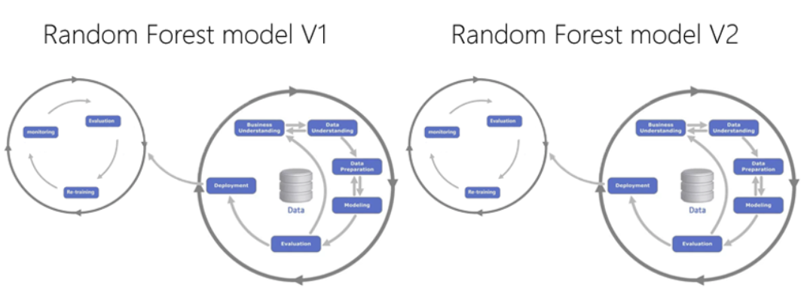
AB Testing scenario

Slide 11
AB Testing scenario
90%
Requests
10%
Smart Load Balancer

Slide 12
AB Testing scenario
Requests
Smart Load Balancer
true
Evaluation
false

Slide 13
Terry McCann 2017

Slide 14
A Smart Load Balancer, just wont work.

Slide 15
But this isn’t the only problem…
Notes:
Meet a great bunch of people
You’re a point of authority
You get to shout at people
You get in for free (save a bit of money)
Free drinks

Slide 16
Terry McCann 2017

Slide 17




Terry McCann 2017

Slide 18
Smallest company
Largest company
5
13
https://mapr.com/ebook/machine-learning-logistics/

Slide 19
Where do you start?
Notes:
Where did I start?

Slide 20
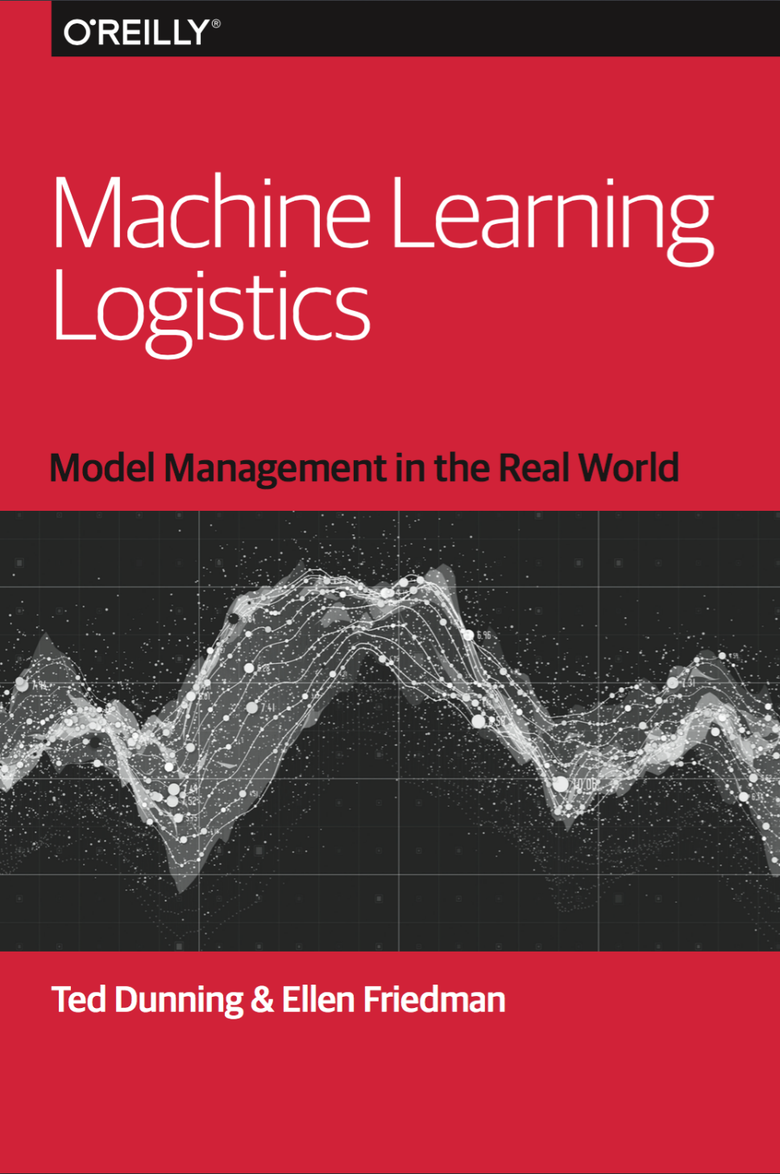
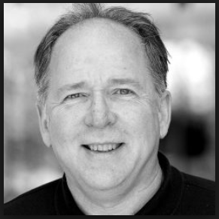
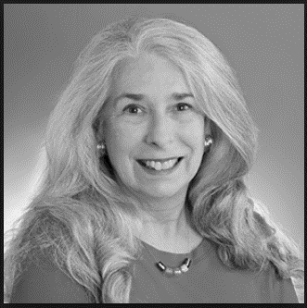
Ted Dunning
https://mapr.com/blog/author/ted-dunning/
Ellen Friedman
https://mapr.com/blog/author/ellen-friedman/
Notes:
Small book around 100 pages
Ellen:
Apache Drill and Apache Mahout

Slide 21
Rendezvous Architecture

Slide 22
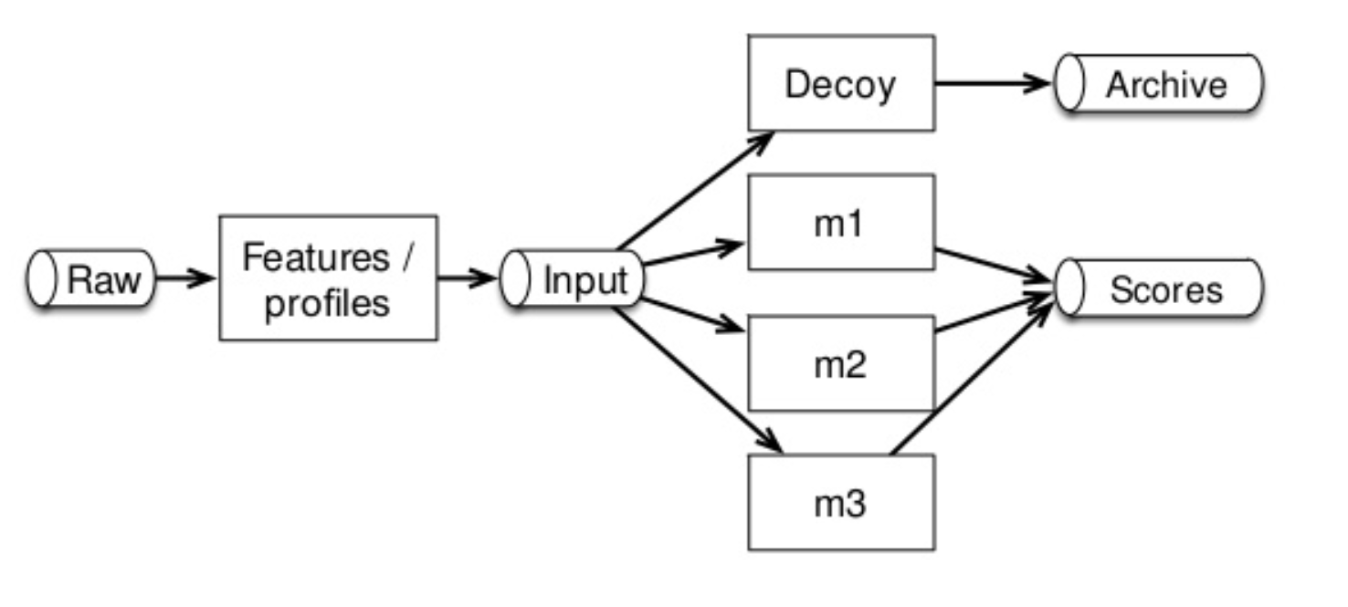
Notes:
Stream first approach

Slide 23
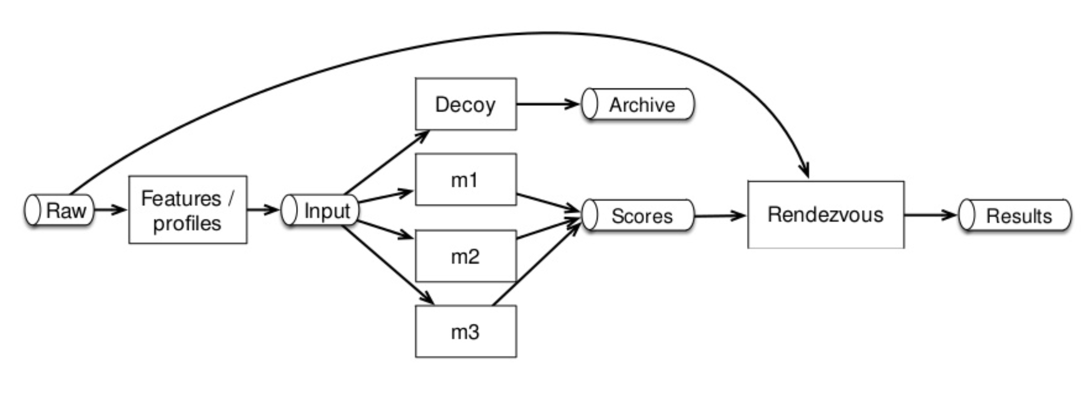

Slide 24
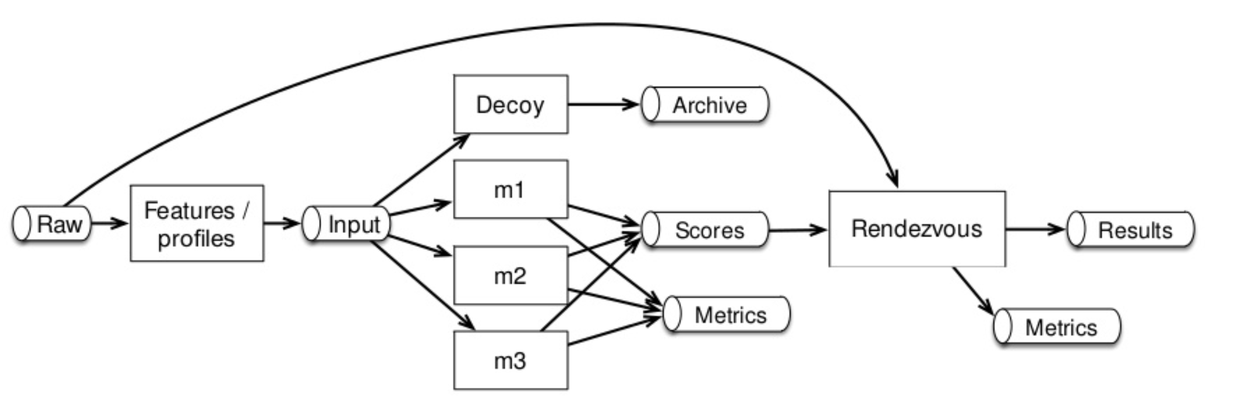

Slide 25

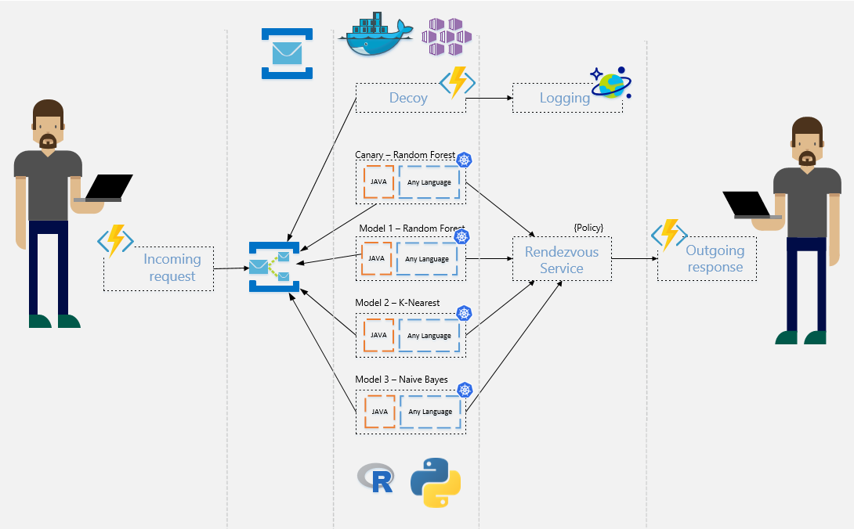

Rendezvous

Slide 26
Rendezvous

Slide 27
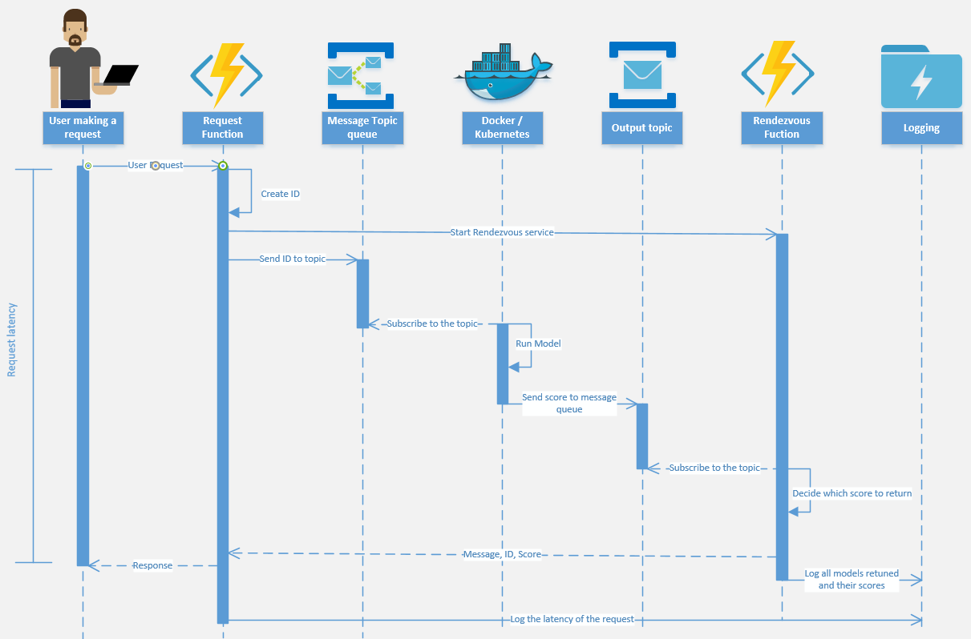
Notes:
Demo after this.
Explain there is a lot of moving parts so let look at a simple model running in Docker.

Slide 28
Do our Data Scientist’s really need to learn all of that?

Slide 29
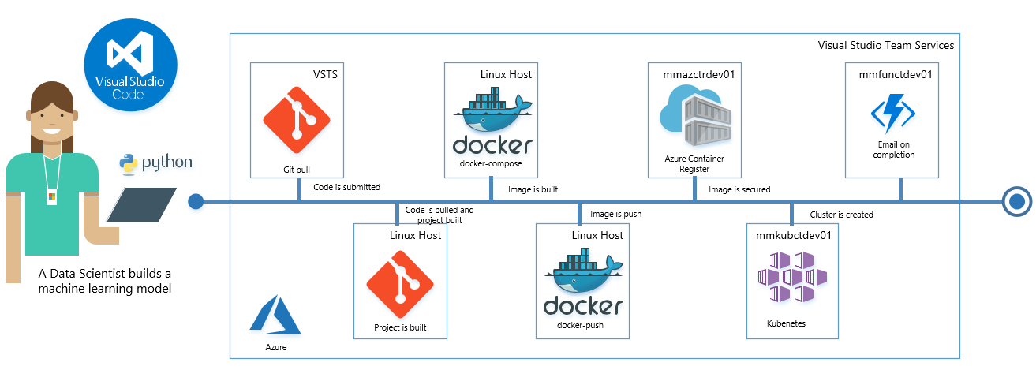
DataOps

Slide 30
Managing multiple models in production
Terry McCann | @SQLShark
Principal Data Scientist
Terry.mccann@adatis.co.uk

